Slide 1
IOWA LEAGUE OF CITIES
ANNUAL CONFERENCE & EXHIBIT
What to Do With an Old Mall or Other Obsolete Space
David Fierke, City Manager, City of Fort Dodge
Chad Schaeffer, Chief Development Officer, City of Fort Dodge
Terry Lutz, PE, Chairman, McClure
HANDOUTS & PRESENTATIONS ARE AVAILABLE THROUGH THE EVENT APP

Slide 2
What Do You Do with an Old Mall or Other Obsolete Space

Slide 3
Must be willing to think differently…

Slide 4
History

Slide 5
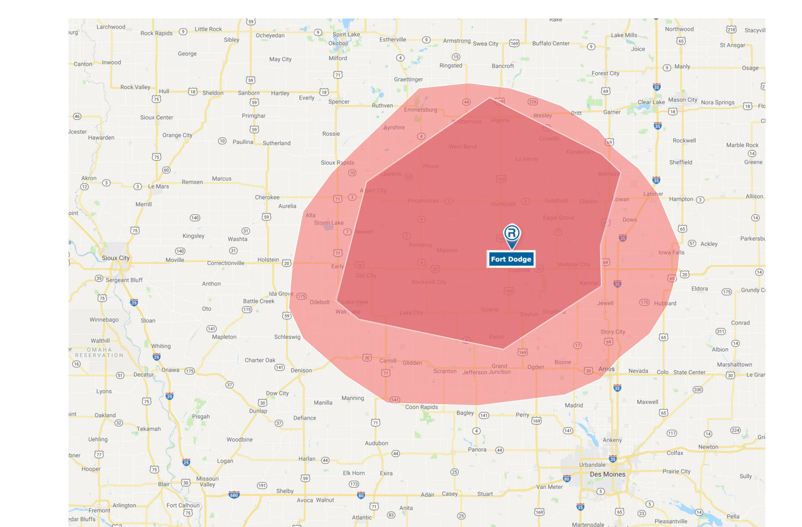
Trade Area
Mason City
Sioux City
Des Moines

Slide 6
Mall History
1960s
Open Air Mall Opens
2000s-2010s
Rent Decreased
Decline Begins
1970s
Mall Enclosed
National Retailers
Killed Downtown

Slide 7
Decline
2010s
Previous Owners Unwilling to Reinvest
2017
JCPenney
Closes
Late 2010s
Developers
Start Looking
2015
Sears
Closes
2018
Younkers
Closes
6x drop in taxable value over 20 years ($12M to $2M)

Slide 8
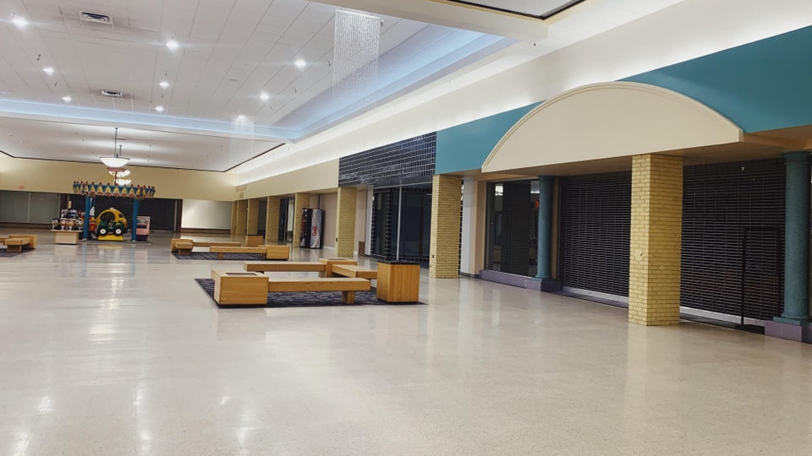

Slide 9
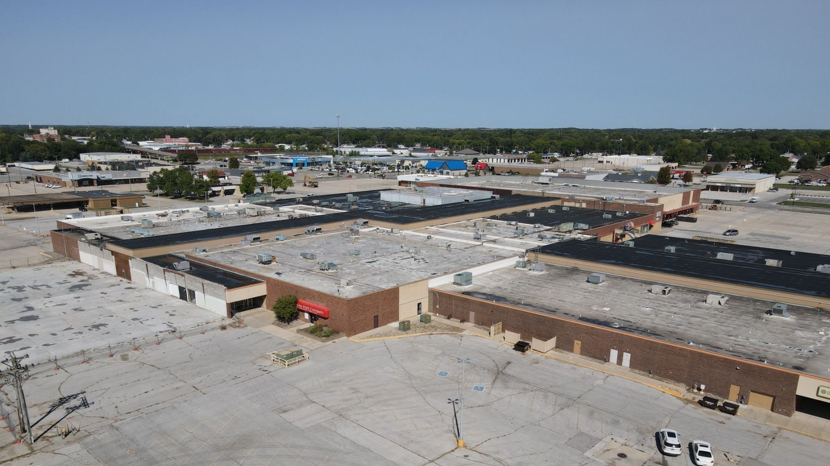

Slide 10
Retail Market – is there hope?
Market Study - Retail Coach
Retail gap analysis
NW Iowa retail hub – strong pull factor!
Service businesses for North Central / Northwest Iowa
11 Hotels – business travelers, contractors, weekend sporting events, etc.

Slide 11
City Involvement in Retail
Historically - no incentives for retail development
Envision 2030 - Strategic Plan
“Retail is quality of life”
City leaders willing to think about retail differently
Big investment to beautify old Highway 20 – commercial corridor
Kohls - catalyst for corridor redevelopment
TIF incentives

Slide 13
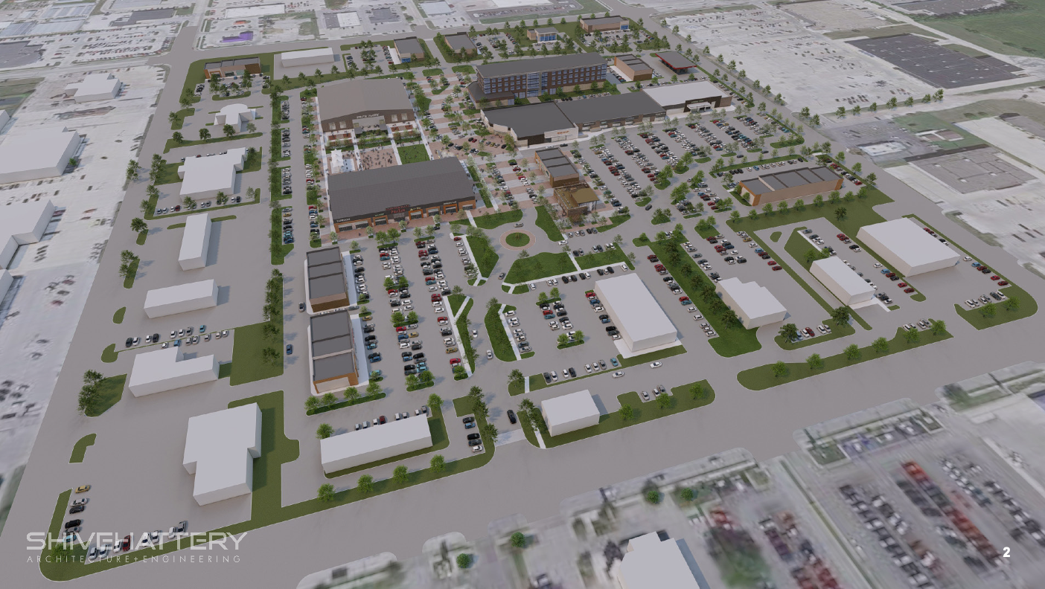
New Concept
Insert Picture

Slide 14
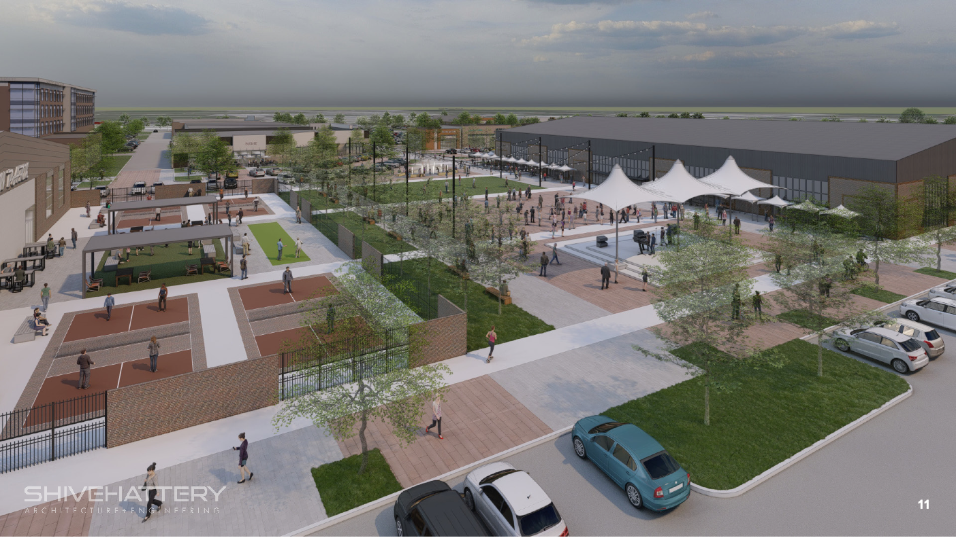
New Concept
Insert Picture

Slide 15
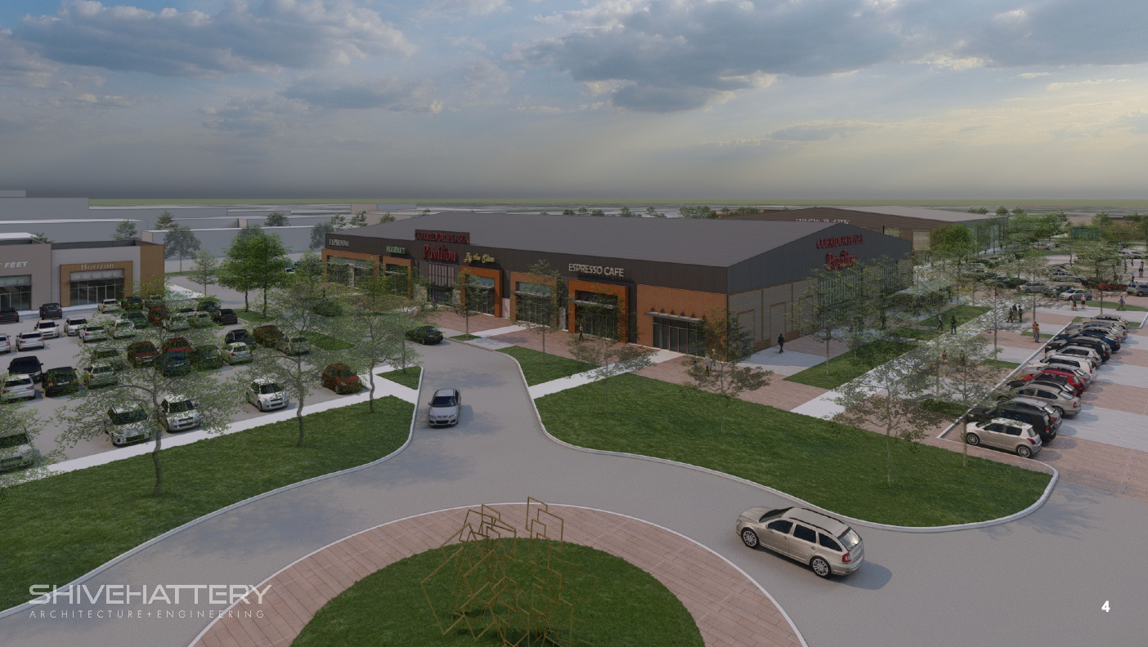
New Concept
Insert Picture

Slide 16
Public-Private Partners

Slide 17
City + Developer = Public-Private Partners!
Both must have skin in the game
Public sector claw-back on real estate if developer fails.

Slide 18
Public sector has
time –
– they think 20, 30, 50, 100 years

Slide 19
Developer does
not have time -
^{they think 2, 3, 5, 10 years}

Slide 20
Heavy up-front costs cannot be carried by developer.
Land Acquisition: $4.5M
Demo/Site Prep: $4.5M Up-Front Costs: $9.0M
$6.50-7.50 / ft²

Slide 21
Without public sector help…
Deal Killer

Slide 22
Financing / Deal Structure

Slide 23
Financing
Land Acquisition $4.5M
Site Demolition $4.5M
Total Initial Costs $9.0M
Site Infrastructure $12.0M
Total Site Prep Costs $21.0M = $15.55/sq ft
Estimated Market Value $2.00 - $4.00/sq ft
Gap in $/sq ft $11.00 - $13.00/sq ft
Gap in total $ $17.0 - $18.0M

Slide 24
Financing
Gap $17.0 - $18.0 million
“Off-Site” TIF $10.0 million
Available to developer as costs are incurred
“On-Site” TIF $8.0 million
To be created by developer and paid as TIF is created – City to issue bonds to reimburse developer

Slide 25
Financing
Public Entertainment Complex Cost $17.0 million
State (Iowa Reinvestment District Program) $17.0 million
Activates the space beyond retail activities to drive retail activities
Year-Round Indoor / Outdoor Activities
Indoor / Outdoor Concerts
Farmers Market
Water Feature
Brewery / Pickleball
Misc. Entertainment

Slide 26
Financing
Site Prep Cost $21.0M
Public Entertainment Complex $17.0M
Vertical Investments $42.0M
(Hotel, Commercial, Retail)
Total Investment $80.0M

Slide 27
Results

Slide 28
Results
Lease Rates
Current $2.00 - $4.00 / sq ft
Post Development
Power Center $6.00 – 14.00 / sq ft
New Strip Center $18.00 - $25.00 / sq ft

Slide 29
Results
Property Taxes
Current $110k / year
Post Re-Development $2.1M / year
Increase $2.0M / year
20 Years $40.0M
30 Years $60.0M
50 Years $100M

Slide 30
Results
Sales Tax
Current $112k / year
Post Re-Development (2025) $1.3M / year
Increase $1.2M / year
20 Years (Thru 2041) $29.8M

Slide 31
New Concept
Insert Picture

Slide 32
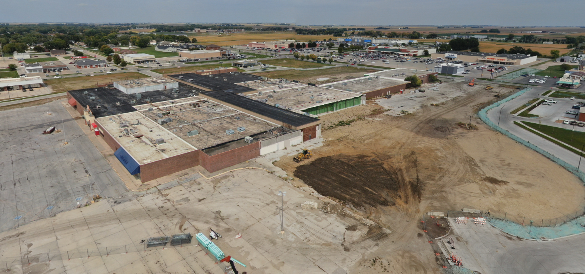
Power Retail Center

Slide 33
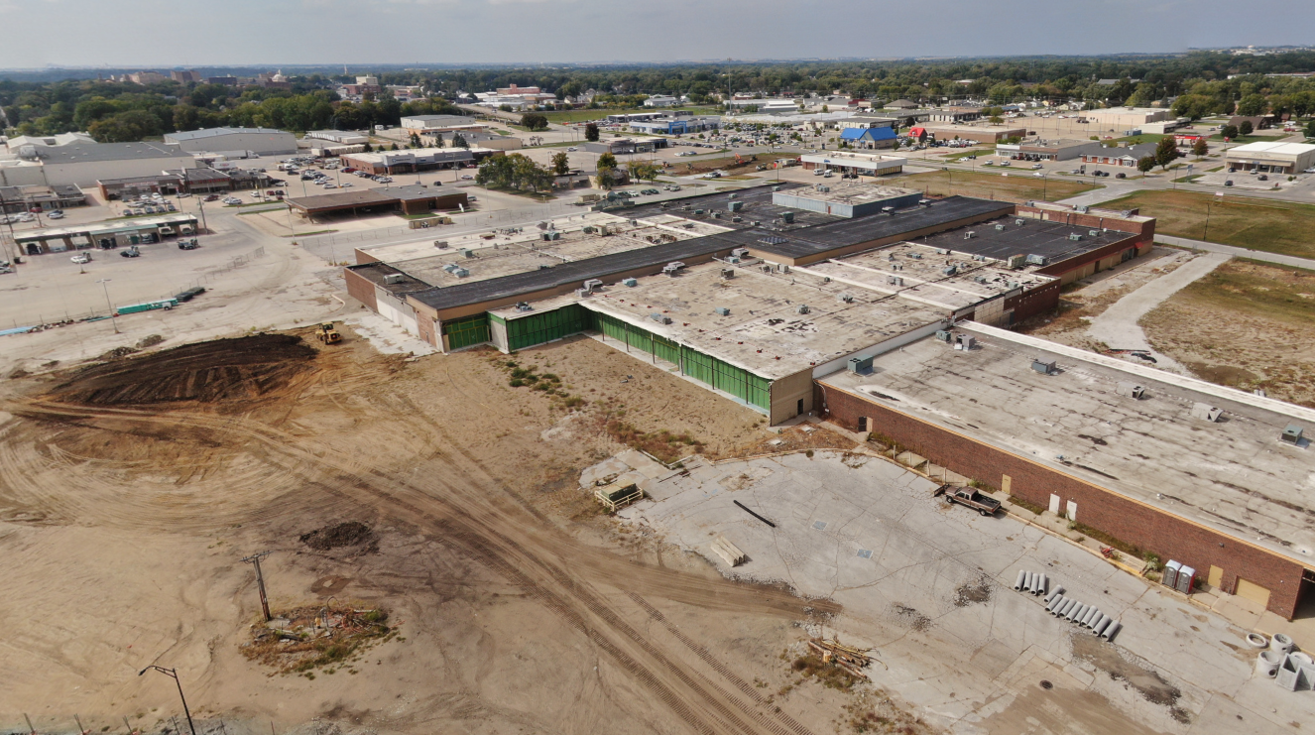
Current Mall
Insert Picture
Power Retail Center

Slide 34
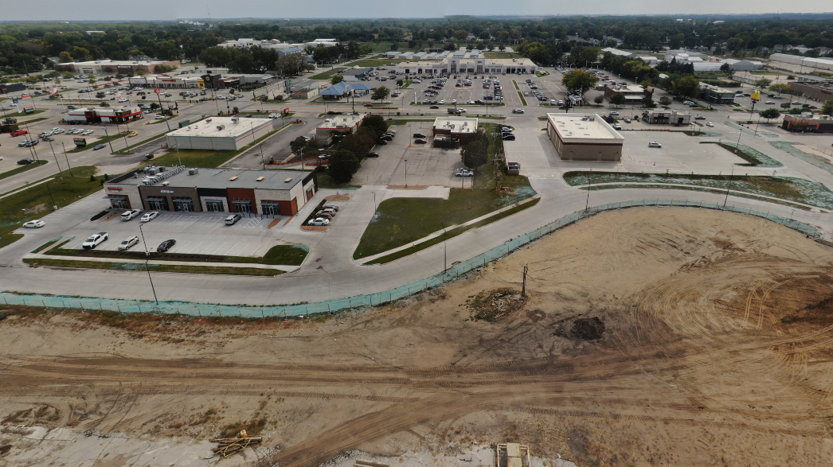
Current Mall
Insert Picture

Slide 35
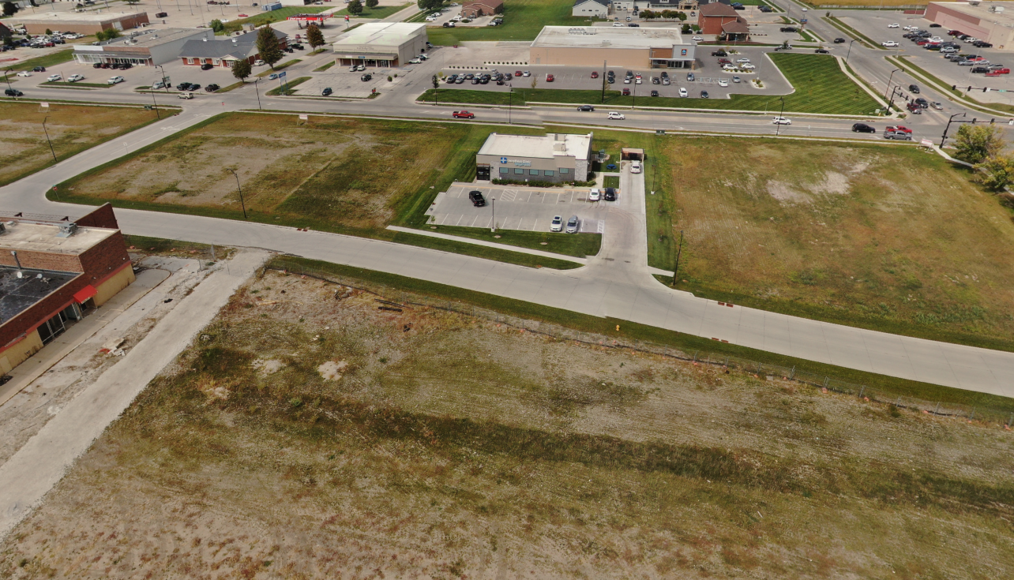
Current Mall
Insert Picture

Slide 36
Don’t let an obsolete property define your city.
Try something!
It’s not a tattoo!

Slide 37
David Fierke
City Manager
515-576-4551 x 2
dfierke@fortdodgeiowa.org
Chad Schaeffer
Chief Development Officer
515-576-4551 x 1004
cschaeffer@fortdodgeiowa.org
BJ Stokesbary
515-520-7851
bj@atirealty.com
Terry Lutz
515-249-9936
tlutz@mcclurevision.com

