Slide 1
Implementing Comprehensive Plans: A Roadmap
Presented by
Rose Schroder, AICP Senior Urban Planner
Iowa League of Cities
Sept. 29, 2022

Slide 2
What’s a Comp Plan?

Slide 3
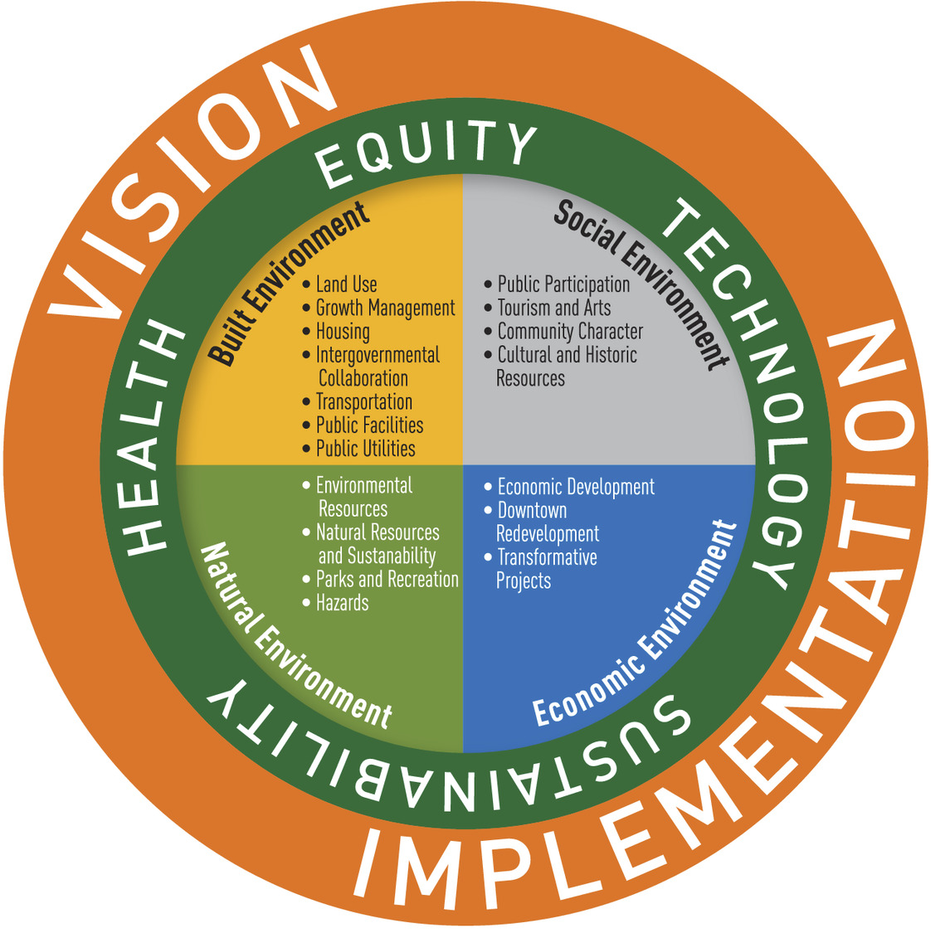

Slide 4
Bring People and Organizations Together

Slide 5
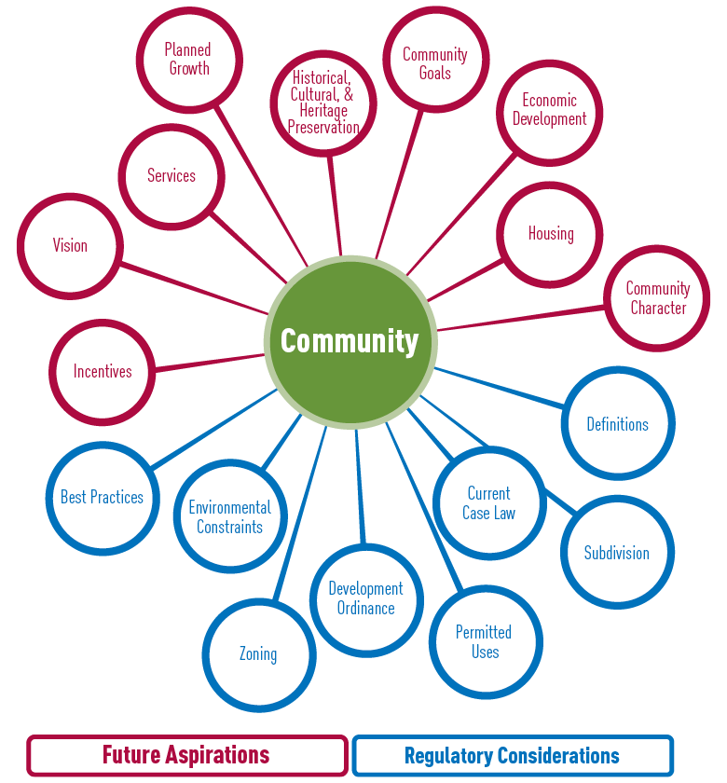

Slide 6
Implementation Matrix
GOAL | ACTION STEPS | TIMELINE
Develop sensitively to preserve natural resources | Create development to avoid environmental impacts and other hazards | Mid-term
Promote infill development for new uses and to fill existing vacancies | Support rezoning for higher densities | On-going
 | Support development efforts in areas with existing utilities | On-going
 | Create development standards to support compact development | Short-term
Build upon community character and historic, artistic appeal | Adopt standards for minimum landscaping requirements | Mid-term
 | Adopt standards that require buffering and/or screening requirements between different types of land uses | Mid-term
 | Use community events to enhance community character, pride, and branding | On-going

Slide 7
Implementation Matrix
GOAL | ACTION STEPS | TIMELINE
Establish and encourage developing a Town Center as an identifiable activity center | Create the Town Center Zoning District to allow mixed use development | Short-term
 | Allow for business establishments to have temporary outdoor displays and outdoor dining opportunities | Short-term
Identify areas for future growth and development. | Designate land to accommodate a variety of uses in locations that are compatible | Short-term
 | Require new residential neighborhoods or provide a pedestrian connection to other parts of the community | Short-term
 | Study the development feasibility of land located northeast abutting the existing community for future annexation | Mid-term

Slide 8
Getting it Done

Slide 9
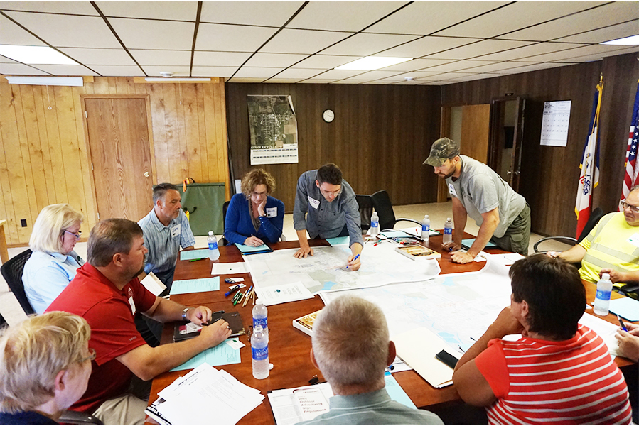
Regulatory Side
Who should be involved?
City
County
Notes:
--Who needs to be involved? City and county cannot do it on their own Cover those groups (public/private partnerships)

Slide 10
Regulations & Goals
Rezoning & standards
Holistic view
Funding Commitment
Common ground for all parties is important, even if goals differ.

Slide 11
Take - Aways
Bring everyone to the table early and often
Keep the community interested
Make regulatory changes to support the policies developed in the plan
Budget Considerations
Use it! Be consistent with land use decisions
Align with partners

Slide 12
Thank you!
Questions?
515-380-4396
Rose.Schroder@bolton-menk.com
Rose Schroder, AICP Sr. Urban Planner

